Slide 1
”DIKSHA” Sundaram Fin.Tech 2025
Journey Presentation –week 8
Anil Rasa
Date : 06-Apr-2025

Slide 2

Topics Covered in Eighth Week !

Slide 3
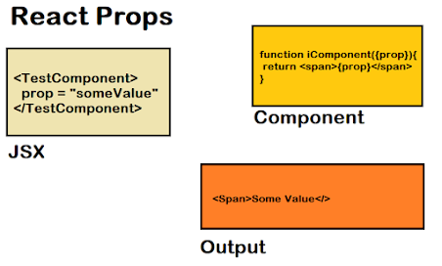
Learning 1 | My takeaways
→Prop Types
→Prop Drilling
→Create Context
→Properties

Slide 4
Properties:
properties (commonly referred to as "props") are a mechanism for passing data from a parent component to a child component. They are read-only and help make components dynamic and reusable.
Features of Props:
Immutable: Props cannot be modified by the child component; they are read-only.
Passed as Attributes: You pass props as attributes in JSX.
Dynamic Data: Props allow you to pass dynamic data.
Prop Types: Prop types are a set of validators used to check the types of props passed to a component helping to catch potential type errors during development and improve code quality.
PropDrilling: Prop drilling in React refers to the practice of passing data down through multiple levels of nested components via props, even when intermediate components do not need the data themselves. This can lead to verbose and hard-to-maintain code, especially in larger applications with complex component hierarchies.
Create Context:
Context, in React, is a way to pass data down through a component tree without having to pass props down through every level. This can be very helpful since this allows us to share data between components that are not directly related to each other.
Q

Slide 5
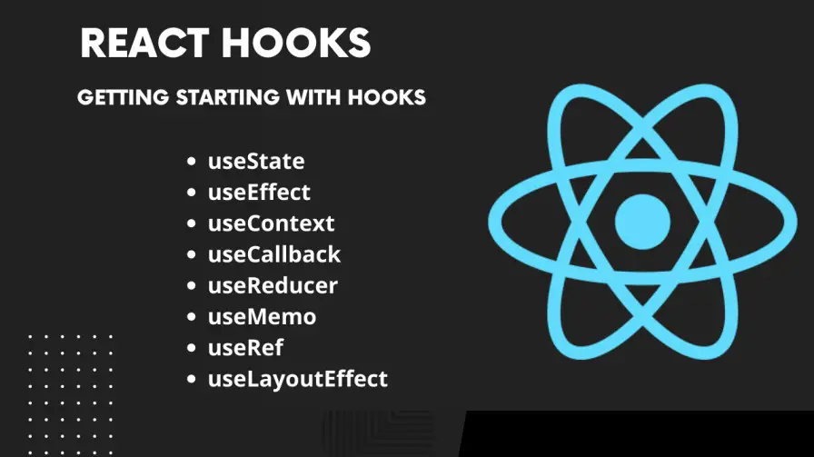
Learning 2| My Takeaways
→ By-pass Prop Drilling
→Hook(UseContext)
→ Event Handling
→Hook(UseState)

Slide 6
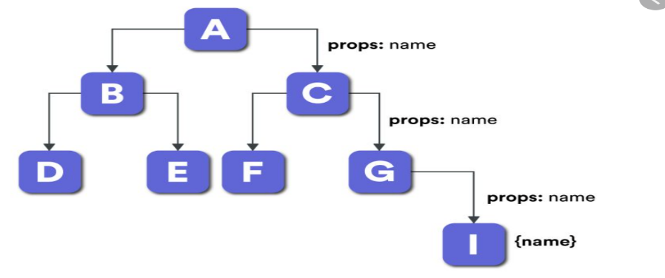
By-pass Prop Drilling:
To "bypass prop drilling" in React means to find alternative
methods for passing data down through the component tree
instead of relying on passing props through multiple
intermediary components that don't directly use the data.
Hook: Hooks are functions that let you “hook into” React state and lifecycle features from function components.
UseContext: The UseContext hook in React is used to consume context values in functional components. It helps in managing global state or shared data without the need to pass props manually through every level of the component tree.
Event Handling in React:
Event handling in React is similar to handling events in plain JavaScript, but with some key differences due to React's synthetic event system.
→Synthetic Events
→Event Naming
→Event Binding
UseState: Hook is one of the most commonly used hooks in React. It allows you to add state management to functional components. Before hooks, state could only be used in class components, but with UseState

Slide 7
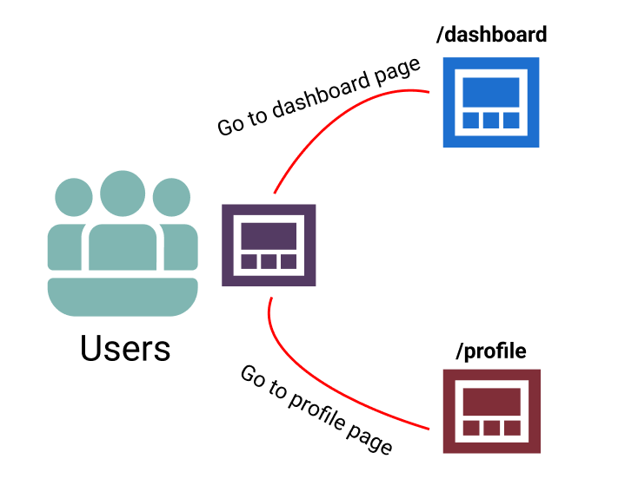
Learning 3| My takeaways
→Hook (UseRef)
→Form
→Routing
→Outlet

Slide 8
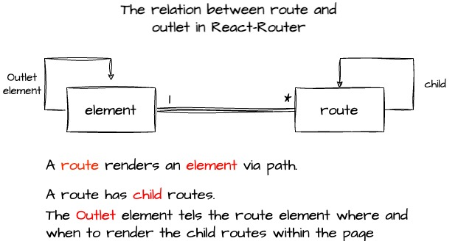
UseRef:
a ref provides a way to access and manipulate DOM elements or component instances directly, allowing you to interact with the DOM outside of React's declarative approach, such as focusing an input field or triggering animations.
Forms:
React forms rely on a single source of truth: the component state. This means that when a user enters data into a form field, the value is not immediately updated in the DOM.
→A form is a tool used to collect information by presenting structured fields or questions for users to fill out
Routing: In React, "routing" refers to the mechanism
that allows users to navigate between different pages
or sections of a web application without a full page reload,
and React Router is a popular library used to implement
this functionality.
Outlet:
It is a placeholder within a parent route's component
that tells React Router where to render the child routes.

Slide 9
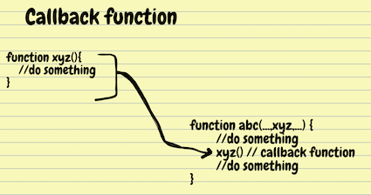
Learning 4 | takeaways
→Parameters
→Mouting and Unmouting
→Hook(UseEffect)
Call back Function
Redux

Slide 10
Parameters:
Parameters, often referred to as params, are dynamic parts of the URL that can change and are set to a specific value when a particular route is matched.
→There are two types of parameters: 1)Path-parameter
2)Query-parameter
Mounting and Unmounting: Mounting and unmounting are key phases in a React component's lifecycle. Mounting refers to the process when a component is created and inserted into the DOM, making it visible on the page. Unmounting, conversely, is the process of removing a component from the DOM, effectively destroying it.
UseEffect: UseEffect is a React Hook that manages side effects in functional components. It serves as a replacement for lifecycle methods found in class components, such as ComponentDidMount,ComponentDitUpdate and componentWillUnmount.
Call Back Function:A callback function is a function passed into another function as an argument, which is then invoked inside the outer function to complete some kind of routine or action. The consumer of a callback-based API writes a function that is passed into the API.
Redux:React Redux provides a pair of custom React hooks that allow your React components to interact with the Redux store. useSelector reads a value from the store state and subscribes to updates, while useDispatch returns the store's dispatch method to let you dispatch actions.

Slide 11
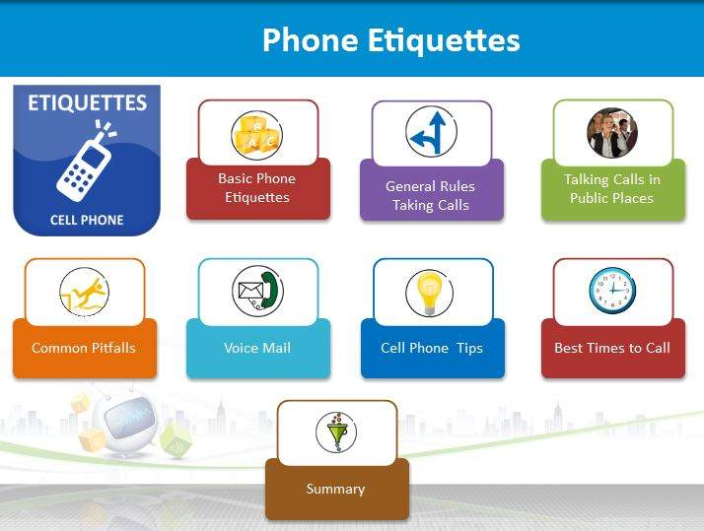
Learning 5 | takeaways
→Effective Listening
→Types of Listening
→Telephone /Mobile Etiquette
→Types of Communication

Slide 12

Effective Listening:
Effective listening, or active listening, involves giving your full
attention, showing engagement through nonverbal cues, asking
clarifying questions, and reflecting back what the speaker said to
ensure understanding
Types of Listening:
Different types of listening include active, empathetic, critical,
appreciative, informational, and discriminative listening, each
serving distinct purposes in communication.
Telephone/Mobile Etiquette:
→Acknowledge
→Assure
→Affirm
→Appriciate
Types of Communication:
→Passive
→Assertive
→Aggressive

Slide 13
Thank You

